Slide 1
Military Institute of Science & Technology (MIST)
Department of Computer Science & Engineering (CSE)
Solution of Simultaneous
Linear Equations
CSE 214
Numerical Methods Sessional
Credit Hr. 1.50, Contact Hr. 3.00
Lec Tarannum Zaki
Dept. of CSE
MIST

Slide 2
OUTLINE
Solution of simultaneous linear equations:
Naïve Gauss Elimination Method
Gauss-Jordan Elimination Method

Slide 3
INTRODUCTION
Linear Equation
An algebraic equation in which each term has an exponent of one and the graphing of the equation results in a straight line.
A standard form of linear equations in two variables:
ax + by + c = 0; where a, b, c are constant and at least one of a and b is non-zero.
Simultaneous Linear Equations
Two (or more) linear equations in two (or more) variables taken together are called simultaneous linear equations. The solution of system of simultaneous linear equation is the ordered pair (x, y) which satisfies both the linear equations.

Slide 4
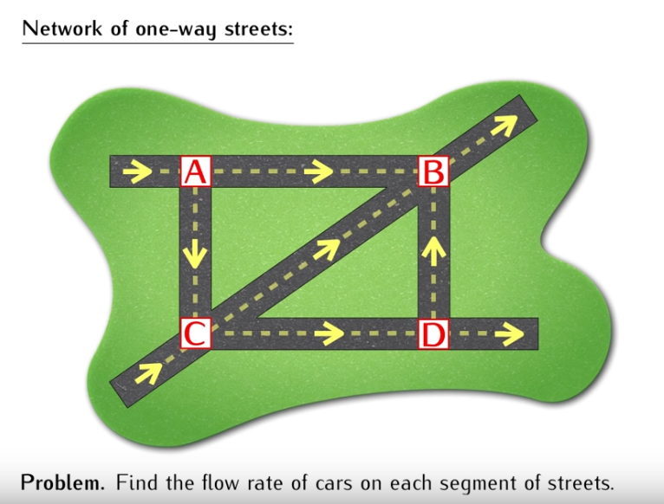
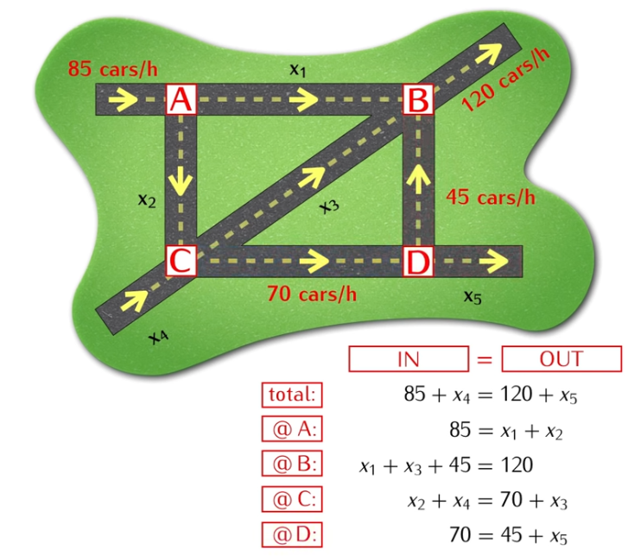
INTRODUCTION
Real Life Example
Computing traffic flow in a network of streets is a common problem traffic engineers face.

Slide 5
INTRODUCTION
Simultaneous Linear Equations: Solution Methods
Direct Method:
1) Naïve Gauss Elimination Method
2) Gauss-Jordan Elimination Method
Indirect Method (iterative method):
1) Gauss-Seidel Elimination Method

Slide 6
INTRODUCTION
Difference between Direct and Indirect Method
Direct Method | Indirect Method
Amount of computation is fixed. | Computation is repeated until required accuracy is obtained.
Advantageous for small systems. | Advantageous for large systems.
Pitfalls: (for large set of equations) 1) division by zero 2) large round of errors | User has control of the round-off error.

Slide 7
INTRODUCTION
Naïve Gauss Elimination Method
Naïve Gauss Elimination method consists of two phases:
Step 01: Forward Elimination of Unknown: the unknown is eliminated in each equation starting with the first equation. This way, the equations are "reduced" to one equation and one unknown in each equation.
Step 02: Back Substitution: starting from the last equation, each of the unknowns is found.

Slide 8
INTRODUCTION
Naïve Gauss Elimination Method
Finally the equations will take the form:
Forward-elimination:
The above set of equations are said to be in triangular (Upper) form.
The first step is to eliminate the first term from Equations (2) and (3)
Backward-substitution:
The reduced equations are:
The next step is to eliminate a₃₂ from the third equation.

Slide 9
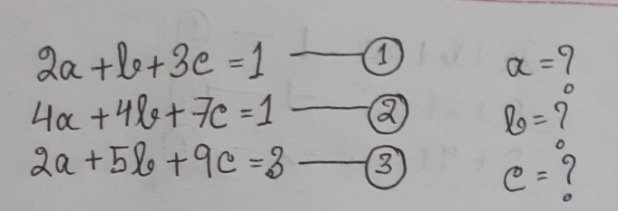
INTRODUCTION
Naïve Gauss Elimination Method: Example

Slide 10
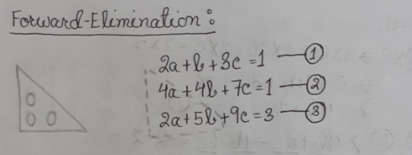
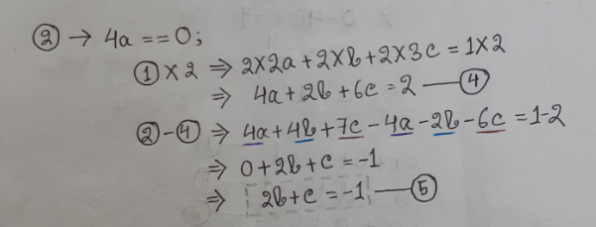
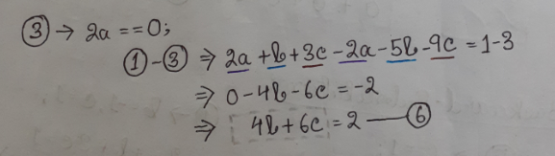
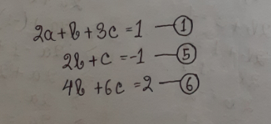

Slide 11
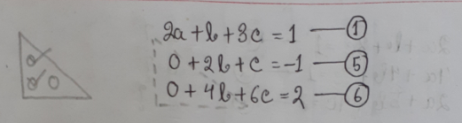
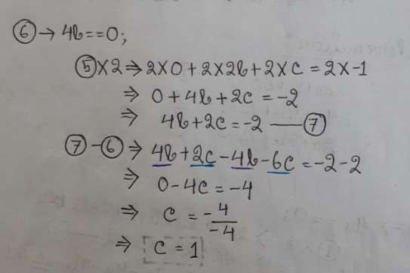
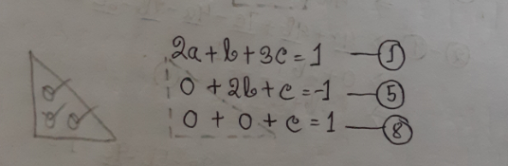

Slide 12
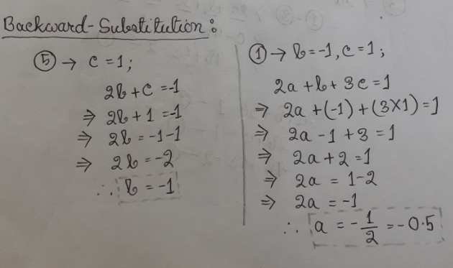
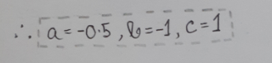

Slide 13
INTRODUCTION
Pivoting
The first nonzero entry of each row is called a pivot. The procedure for picking the largest element as pivot and interchange the equations is known as pivoting.
Partial Pivoting
Partial pivoting interchanges rows (or columns) in order to use the largest (by absolute value) element in the matrix as the pivot.
When pivoting is required?
This method is applicable only when the diagonal element (i=1, 2, 3 …) are not vanished in the whole calculation.
If diagonal element a_{ii} are zero or close to zero at the beginning of the solution, then rearrange or pivot the equations to avoid nonzero diagonal element (only at the beginning of the solution).
During calculation if any new pivot element becomes zero, then there will be no solution of the system.
Pivot element should be the largest in absolute value of all the elements below it in its column.
NOTE: It should be noted that interchange of equations does not affect the solution.

Slide 14
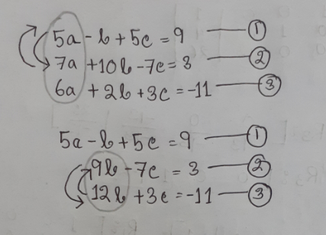
INTRODUCTION
Naïve Gauss Elimination with Pivoting

Slide 15
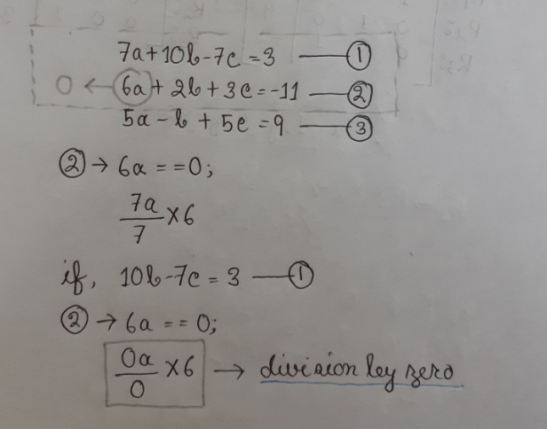
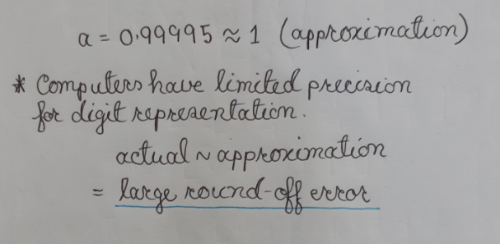
INTRODUCTION
Why pivoting is required?
Avoids division by zero
Reduces large round-off errors (the difference between a rounded-off numerical value and the actual value)

Slide 16
INTRODUCTION
Gauss-Jordan Elimination Method
Gauss Jordan Elimination method consists of three phases:
Step 01: Eliminate an unknown from all other equation rather than just from the subsequent ones.
Step 02: All rows are normalized by dividing them by their pivot elements.
Step 03: After doing the above steps, the result will be an identity matrix.
NOTE: Initially, check all the coefficient of the pivoting elements. If require, swap the rows (partial pivoting).

Slide 17
INTRODUCTION
1st Step R2=R2-R1* a₂₁/ a₁₁; R3=R3-R1* a₃₁/ a₁₁; | 2nd Step R1=R1-R2* a₁₂/ a₂₂; R3=R3-R2* a₃₂/ a₂₂;
3rd Step R1=R1-R3* a₁₃/ a₃₃; R2=R2-R3 * a₂₃/ a₃₃;
Gauss-Jordan Elimination Method
So after running the 3 steps, the matrices becomes like following:
R1 = [1 0 0 R1(4) ];
R2 = [0 1 0 R2(4)];
R3 = [0 0 1 R3(4)];
So, the roots are
x₁= R1(4)
x₂= R2(4)
x₃= R3(4)
The system can be written as
R1 = [a₁₁ a₁₂ a₁₃ b₁ ]
R2 = [a₂₁ a₂₂ a₂₃ b₂]
R3 = [a₃₁ a₃₂ a₃₃ b₃]
At first, check all the coefficient of the pivoting element and swap if required. Then manipulate the 3 matrices in the following 3 steps so that the right hand side of the equation becomes a Unit matrix.

Slide 18
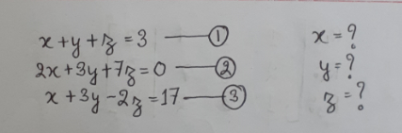
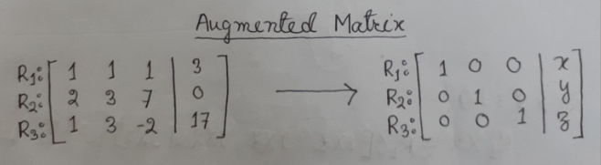
INTRODUCTION
Gauss-Jordan Elimination Method: Example

Slide 19
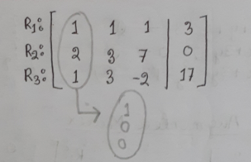
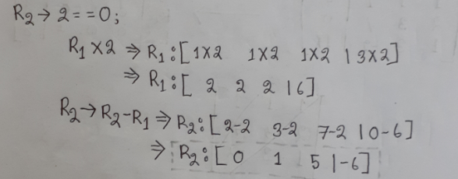
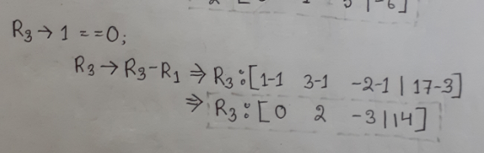
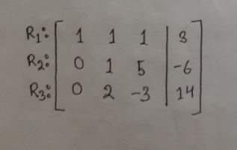

Slide 20
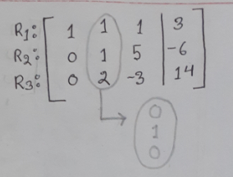
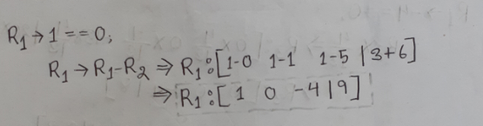
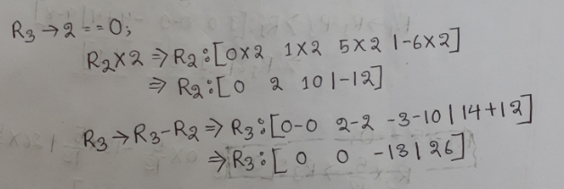
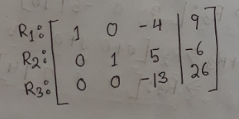

Slide 21
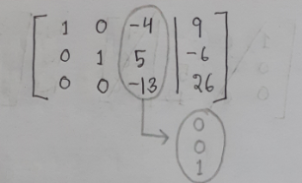
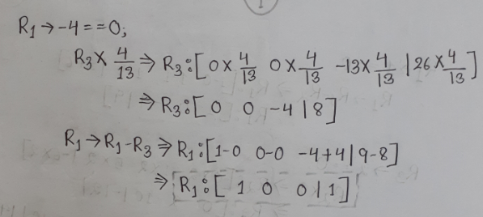
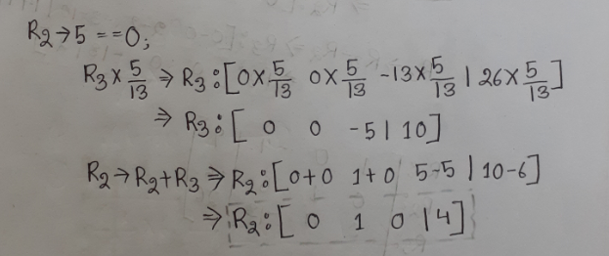
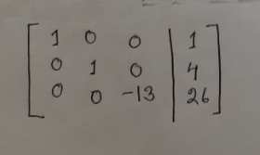

Slide 22
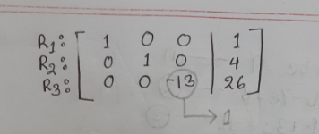
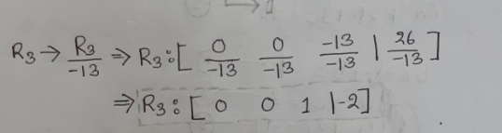
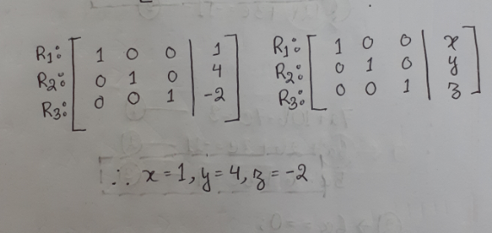

Slide 23
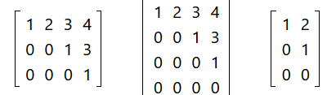
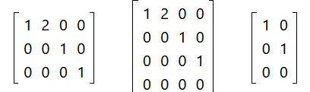
INTRODUCTION
Difference between Naïve Gauss and Gauss-Jordan Elimination Method
Naïve Gauss Elimination Method | Gauss-Jordan Elimination Method
Row Echelon Form | Reduced Row Echelon Form

Slide 24
THANK YOU

